Slide 1


Vision Transformers for Biometric Face Recognition
EE622: Advanced Biometrics
Week 4 Theory
Summer 2025
Aaron W. Storey
Notes:
Welcome to Week 4. Today we're examining how Vision Transformers are revolutionizing biometric face recognition systems. As biometric professionals, you know the challenges: handling variations, ensuring fairness, and maintaining security. ViT addresses these systematically.

Slide 2
Learning Objectives
Compare and contrast traditional face recognition methods (PCA, LDA, LBP, CNN) with Vision Transformers in terms of accuracy, interpretability, and handling of biometric challenges.
Implement and evaluate a ViT-based face recognition system that achieves >95% accuracy while meeting ISO/IEC 19795 biometric performance standards.
Analyze attention visualizations to identify discriminative facial features and diagnose system behavior under occlusion, pose variation, and demographic differences.
Design secure biometric templates using ViT embeddings with cancelable biometrics for privacy-preserving face recognition systems.

Slide 3
Facial Biometric Systems
Advantages: Non-contact, infrastructure, acceptance
Challenges: Pose, illumination, expression, aging, occlusion
Applications: Security, surveillance, ID verification
Notes:
Let's review face biometrics fundamentals from Chapter 3. Face offers unique advantages: non-contact capture, existing infrastructure in passports and licenses, and public acceptance. But we face serious challenges - pose, illumination, expression, aging, and occlusion all degrade performance. Look at the variation diagram - each factor compounds recognition difficulty.

Slide 4
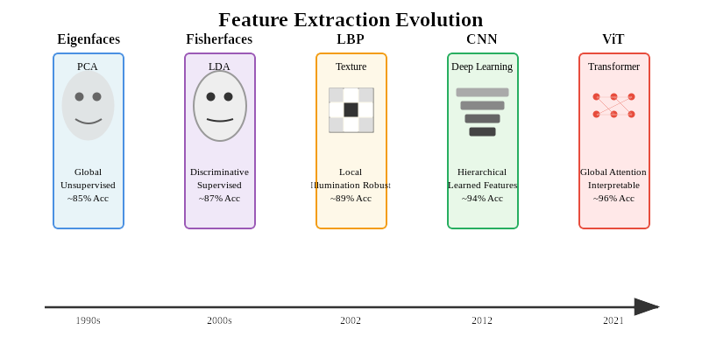
Biometric Pipeline
Acquisition → Detection → Feature Extraction → Matching
Evolution: Manual → Statistical → Deep Learning
Metrics: FAR, FRR, EER
Notes:
The traditional biometric pipeline hasn't changed much: acquisition, detection, feature extraction, and matching. What has evolved is HOW we extract features. We started with handcrafted features, moved to statistical methods like PCA, then local descriptors like LBP, and finally deep learning. Each evolution addressed specific limitations of previous methods.

Slide 5
Handcrafted to Learned Features
Eigenfaces: Global appearance
Fisherfaces: Discriminative, supervised
LBP: Texture-based
CNNs: Hierarchical learning
Notes:
This progression is important. Eigenfaces gave us dimensionality reduction but weren't discriminative. Fisherfaces added supervision but required many samples per person. LBP provided illumination robustness but missed global structure. CNNs learned features automatically but built them hierarchically, potentially missing long-range relationships. Vision Transformers see everything at once through global attention.

Slide 6
Better Approaches?
Intra-class variation > inter-class
CNNs: Limited receptive field
Need global dependency modeling
Notes:
The fundamental challenge: variations within the same person often exceed differences between people. Same person smiling vs serious can look more different than two strangers in identical conditions.
CNNs worsen this through limited receptive fields. Early layers see only 3×3 patches - edges and textures. They can't capture global identity patterns like eye-to-mouth relationships. Only deep layers see the full face, but by then it's too late.
When faces are occluded or rotated, this hierarchical processing fails. If early features are disrupted, everything downstream breaks.
We need global dependency modeling from layer one - where every facial region directly interacts with every other region. Vision Transformers provide exactly this through self-attention. It's not incremental improvement; it's architectural revolution for biometrics.

Slide 7
Biometric Requirements
ISO/IEC 19795: FAR < 0.001%, FRR < 1%
Template protection (GDPR, BIPA)
Demographic fairness
Notes:
Before discussing ViT, let's establish our evaluation criteria. ISO/IEC 19795 defines standard metrics: FAR, FRR, and EER. For high-security applications, we need FAR below 0.001% while keeping FRR under 1%. This is the fundamental trade-off - security versus user convenience. Remember, biometric systems aren't just about accuracy; they're about managing this trade-off appropriately for each application.

Slide 8
Why ViT?
Global receptive field
Modeling part relationships
Handles occlusion & variation
Interpretable attention
Notes:
So why are Vision Transformers particularly suited for biometric challenges? Look at the mapping: Pose variation is handled by global context - all facial parts interact directly. Partial occlusion? Attention redistributes to visible features. Aging? Temporal modeling can focus on stable features. Demographics? Interpretable decisions help identify and mitigate bias. These aren't just incremental improvements; they're architectural advantages.

Slide 9
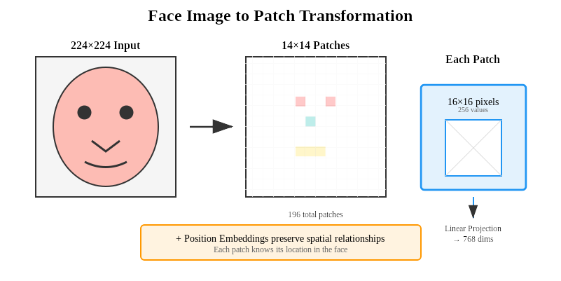
Pixels to Patches
224x224 image → 14x14 patches
Each patch: 16x16
Position embedding + linear projection
Notes:
Here's how we adapt ViT for biometric systems. We use google/vit-base-patch16-224 as our backbone - 86 million parameters processing 224×224 images. Notice the quality check module - this is critical for enrollment and authentication. Poor quality samples degrade the entire system. The transformer creates 512-dimensional secure templates. We also integrate presentation attack detection directly into the architecture.

Slide 10
Whats important for Identity?
Multi-head attention on facial parts
Robust to occlusion
Feature importance visualization
Notes:
Attention mechanisms answer a fundamental question: which features define identity? The model learns to focus on eye geometry, nose-mouth relationships, and face contours. But here's the key - this focus adapts based on available information. If eyes are occluded, attention shifts to other discriminative features. This adaptive behavior is crucial for real-world biometric systems.

Slide 11
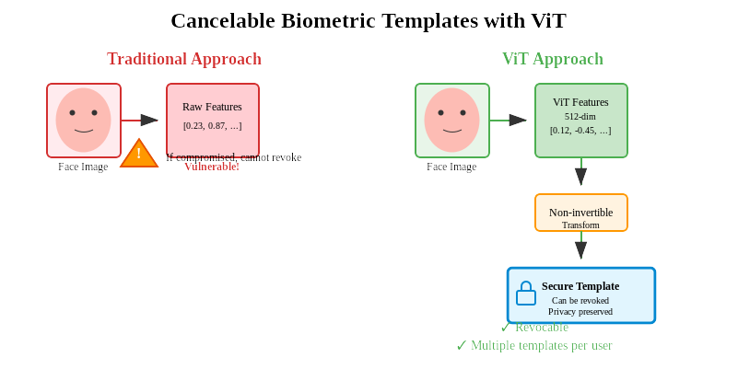
Biometric Data Protection
Traditional = raw features
ViT = cancelable templates
Revocation and re-issuance possible
Notes:
Traditional systems store raw biometric features - actual measurements from your face. Once stolen, they're compromised forever. You can't change your face like a password.
ViT enables cancelable biometrics. The 512-dimensional embeddings undergo a non-invertible transformation before storage. Think of it as a one-way mathematical lock. Even if hackers steal the template, they can't reverse-engineer your facial features.
The game-changer: if a breach occurs, we revoke the compromised template and issue a new one using a different transformation. Same face, new secure template. This addresses GDPR requirements and BIPA compliance.
It's the difference between losing your house key versus losing your fingerprint - one you can replace, the other you can't."

Slide 12
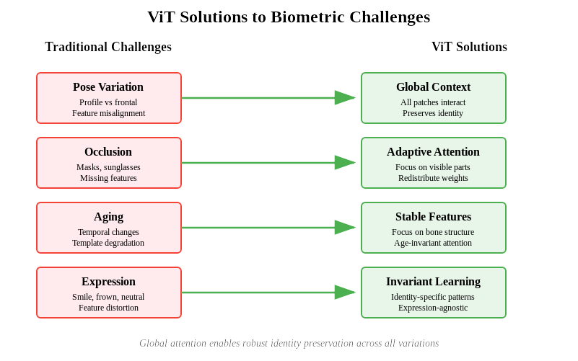
Classic Problems? ViT Solutions

Slide 13
DeepFake Detection
Attention patterns differ: real vs spoof
Detects print, replay, 3D mask attacks
Notes:
Liveness detection is integrated, not added. Attention patterns differ between genuine faces and spoofs. Print attacks lack fine texture - attention becomes unnaturally uniform. Screen presentations show display artifacts. 3D masks fool geometry but not texture attention. By analyzing attention anomalies across multiple heads, we achieve robust PAD without separate systems.

Slide 14
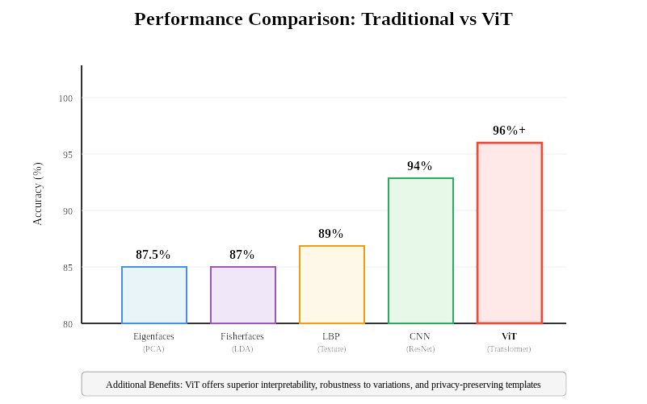
ViT vs Traditional Methods

Slide 15
Bias in Biometrics
Analyze attention by demographic
Evaluate consistency
Fairness-aware training
Notes:
Following ISO/IEC 19795 standards, we evaluate comprehensively. Beyond basic FAR/FRR, we measure demographic parity, quality metrics, and failure rates. Our implementation achieves competitive EER with additional benefits: interpretability for debugging, fairness analysis capabilities, and integrated quality assessment scoring between 0-1

Slide 16
Summary
ViT = performance + interpretability + privacy
Next Week: Cross-Attention Networks for Facial Attribute Analysis

